Slide 1
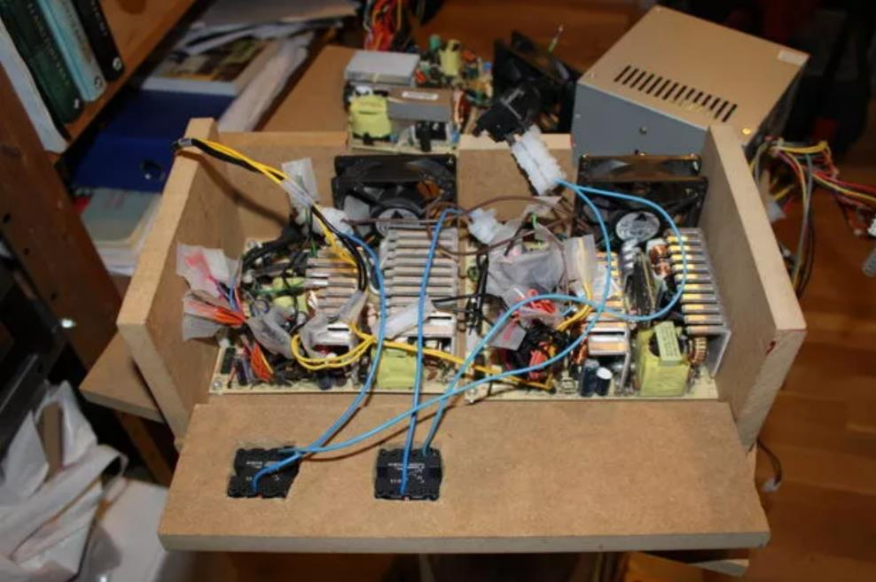
Basic Electronics Components
Feb-2019

Slide 2


Rules of thumb, assumptions and mixed-quality analogies to come!

Slide 3

Plumbing Analogy

Slide 4
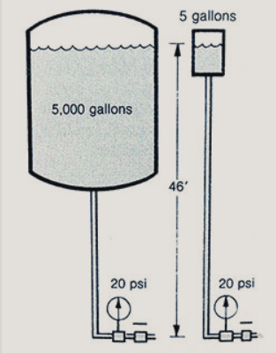
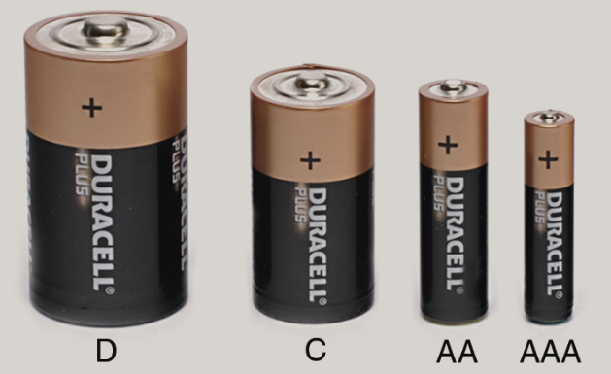
Voltage
+
+
+
+
1.5V
1.5V
1.5V
1.5V
-
-
-
-

Slide 5
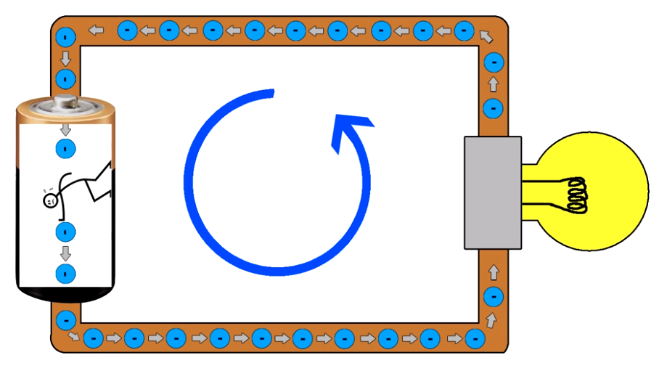
Powering a Light Bulb
Voltage is the pushing force
Pushes electrons through a circuit

Slide 6
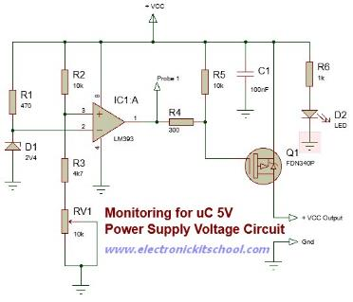
Powering a Complex Circuit
12V
Voltage is applied across any circuit to power it

Slide 7
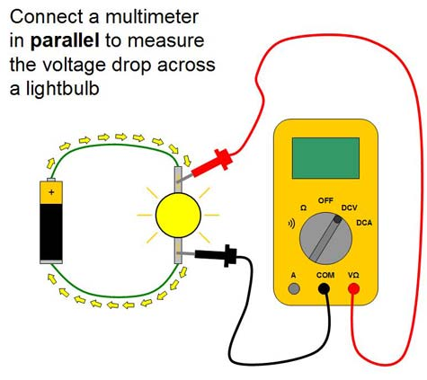
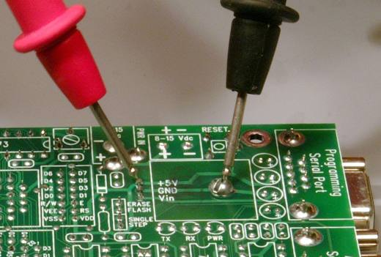
Measuring Voltage
Voltage is measured between two points:
Common (reference, ground)
Positive

Slide 8
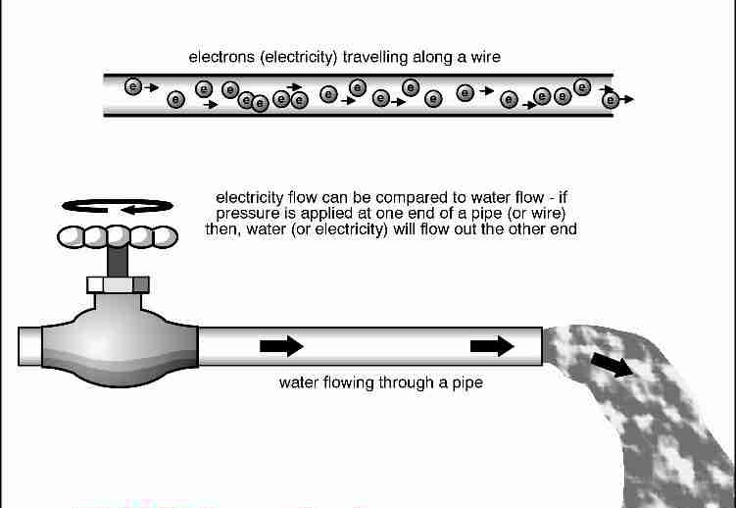
Current
Current is the flow of electrons
Similar to the flow of water

Slide 9
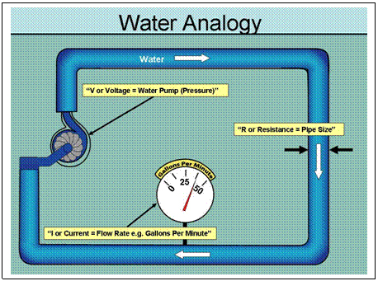
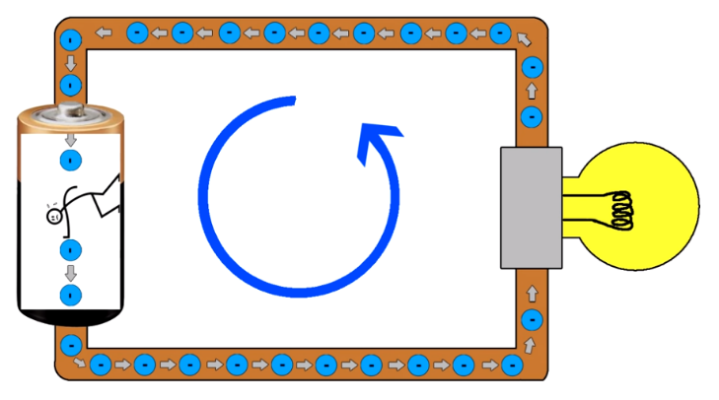
Current
Measured in amps
1A (1 amp) = 6.25 x 10¹⁸ electrons per second

Slide 10
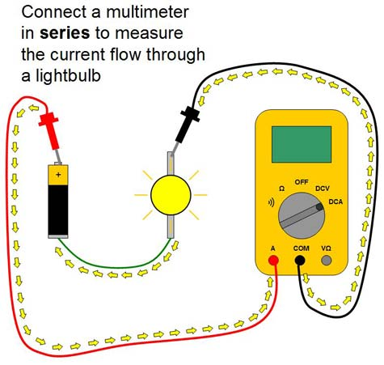
Measuring Current
Current can be measured by passing it through a multimeter

Slide 11

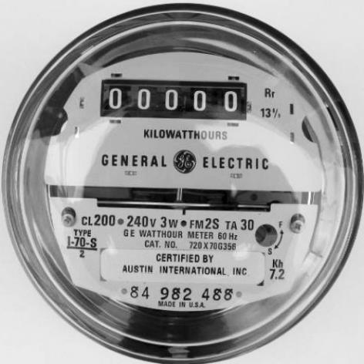
Power
Power = Watts = Amount of energy used at a particular point in time
Energy =
Power x Time = W x hr
Total energy a house uses in a month

Slide 12
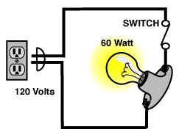
Calculating Power
Power = Voltage x Current
120V x 0.5A = 60W

Slide 13
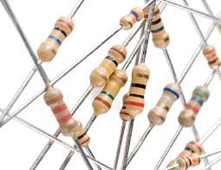
Resistors – A minute to learn, a lifetime to master

Slide 14


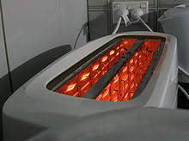

We use them every day

Slide 15
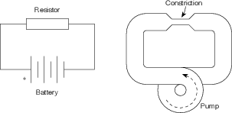
Resistors – Resist the flow of current
Resistance – measured in Ohms (Ω)

Slide 16
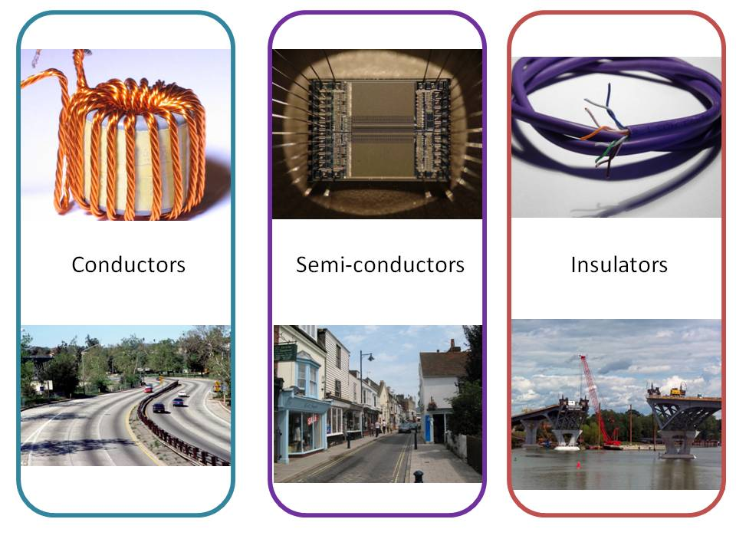
Conductors vs Insulators

Slide 17
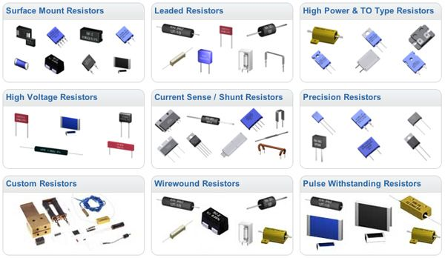
All Shapes and Sizes

Slide 18
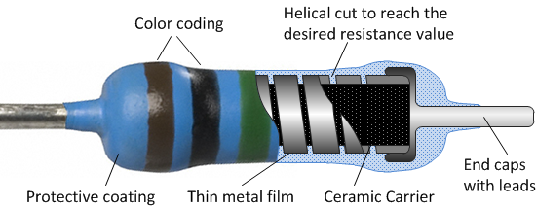
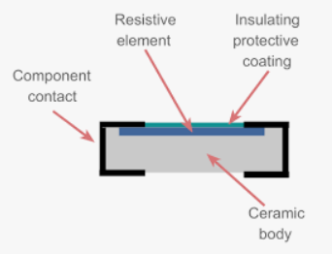
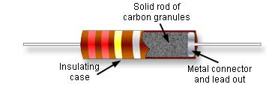
Fixed Resistors – Construction

Slide 19
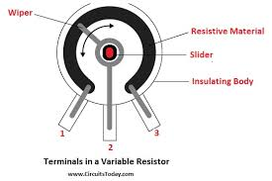
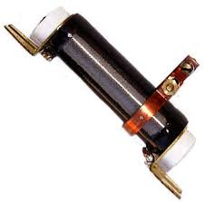
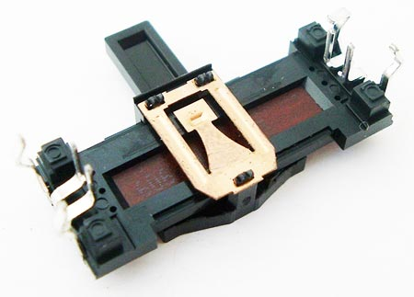
Variable Resistors – Construction

Slide 20
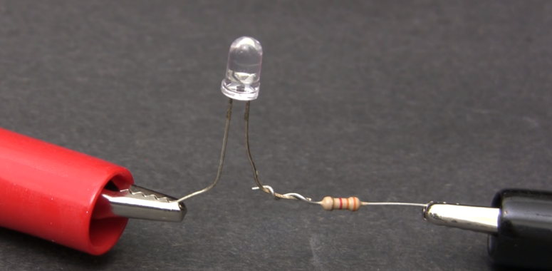
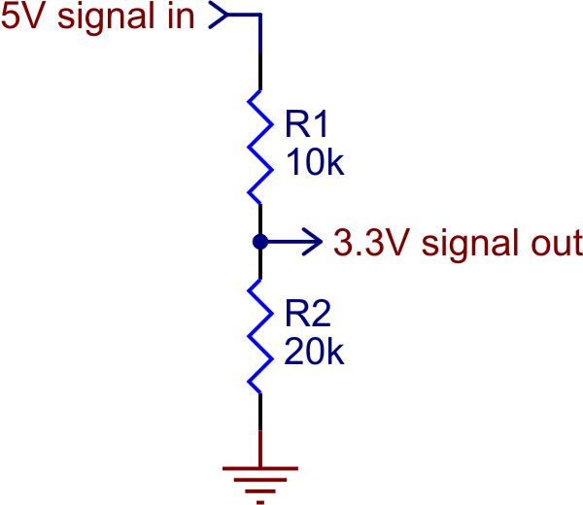
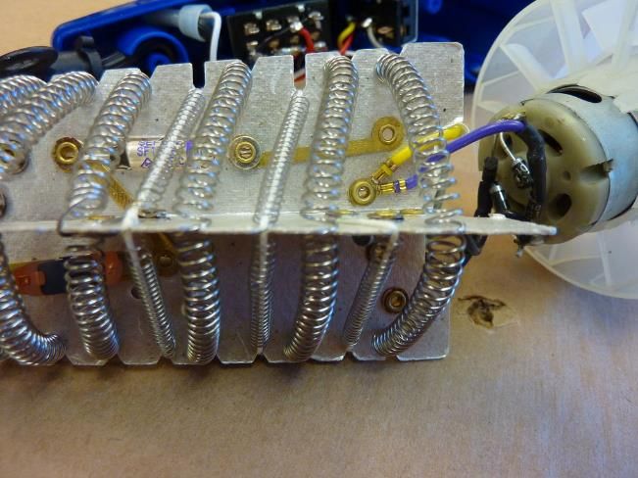
Resistors – Simple but useful!

Slide 21

Ohm’s Law
V = I * R
Special Relationship between voltage, current, resistance

Slide 22
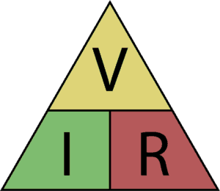

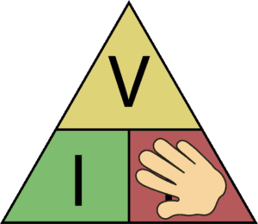
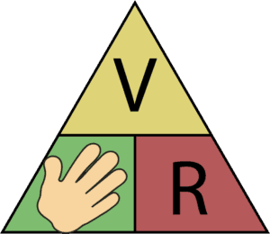
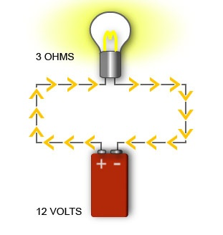
Ohm’s Law
V = I * R
R = V / I
I = V / R
I=0.5A
120V

Slide 23
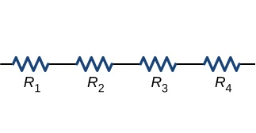

Resistors in Series
=
10Ω
10Ω
10Ω
10Ω
40Ω
R₁ + R₂ + R₃ + R₄

Slide 24
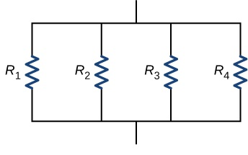

Resistors in Parallel
=
40Ω
40Ω
40Ω
40Ω
R_{T}
10Ω
1
R_{T} =
1
R₁
+
1
R₂
+
1
R₃
+
1
R₄

Slide 25
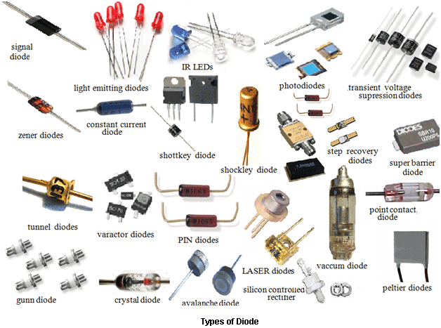
Diodes/LEDs

Slide 26


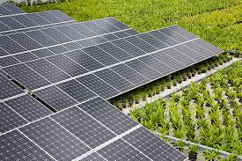
Diodes – Everyday Uses

Slide 27
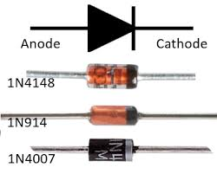
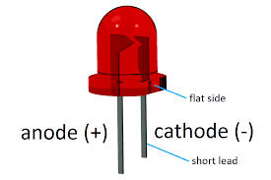
Diodes – One-Way Gate
Current Flow
LED

Slide 28
How to use a diode
I_{LED}
R
V_{S} > V_{LED} + 1V
I_{LED} ~ 10-20mA
V_{LED} ~ 1.8-3.3V
V_{S}
+
-
+
V_{LED}
-

Slide 29
Practical Circuit
I = 10mA
V_{S} = 5V
R = ?
+
-
+
V_{LED} = 2V
R = V / I
-
R = (5V – 2V) / 0.01A
= 3V / 0.01A
= 300Ω

Slide 30
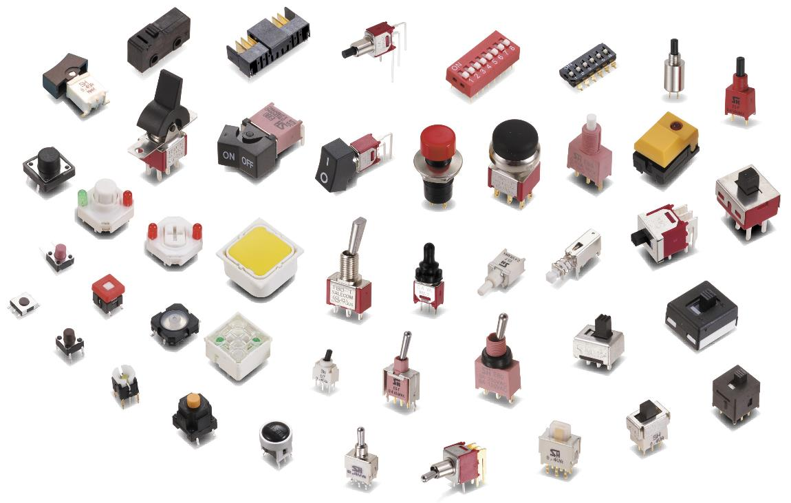
Switches

Slide 31
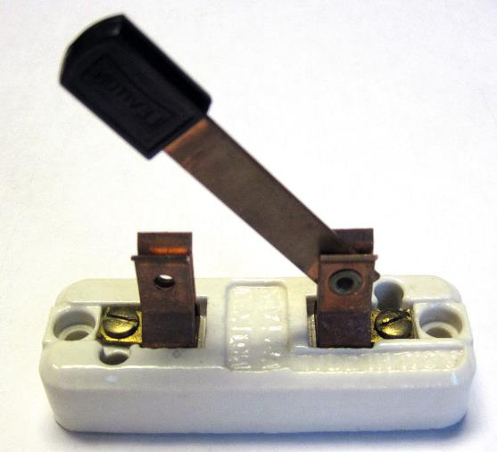
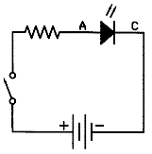
Switch Example

Slide 32
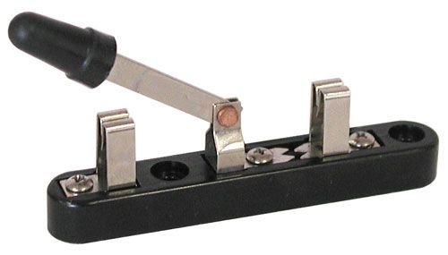
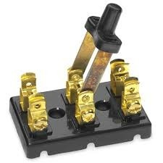
More Switch Types

Slide 33
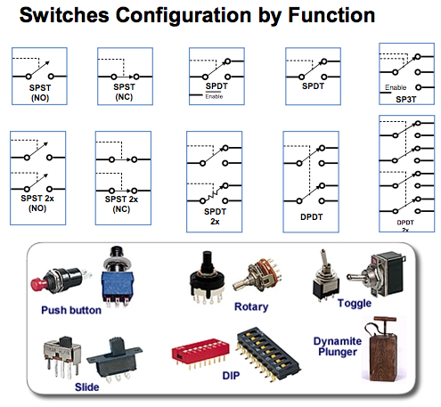
Poles and Throws

Slide 34
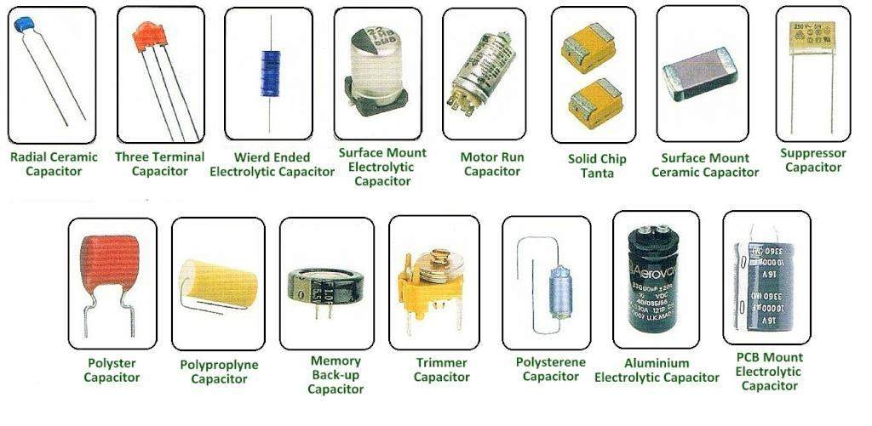
Capacitors

Slide 35
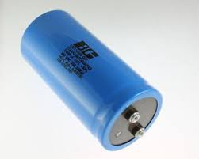
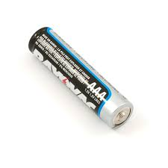
Similar to Batteries

Slide 36
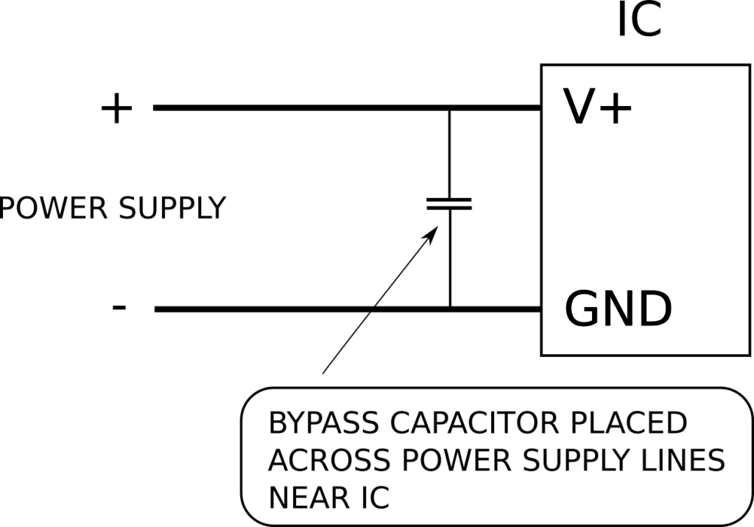
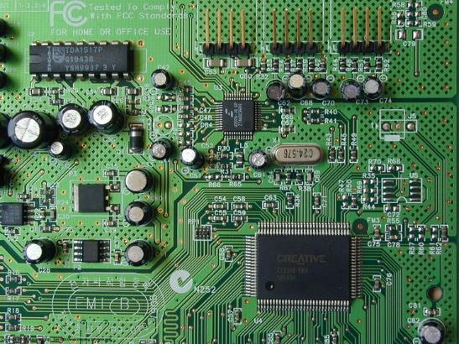
“Supply Bypass” Capacitors

Slide 37
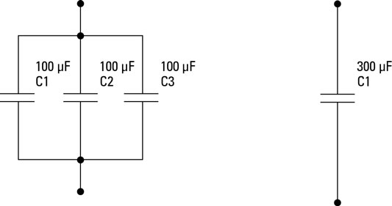
Capacitors in Parallel
C_{T} = C₁ + C₂ + C₃

Slide 38
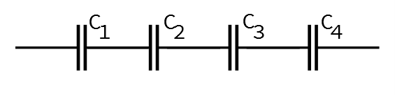


Capacitors in Series
c
C_{total}
c

Slide 39
Further Reading
Falstad Circuit Simulator – Runs in Browser
Mattermost Channel
YouTube Videos
All About Circuits
https://www.allaboutcircuits.com/education/
Sparkfun – learn.sparkfun.com

